Slide 1
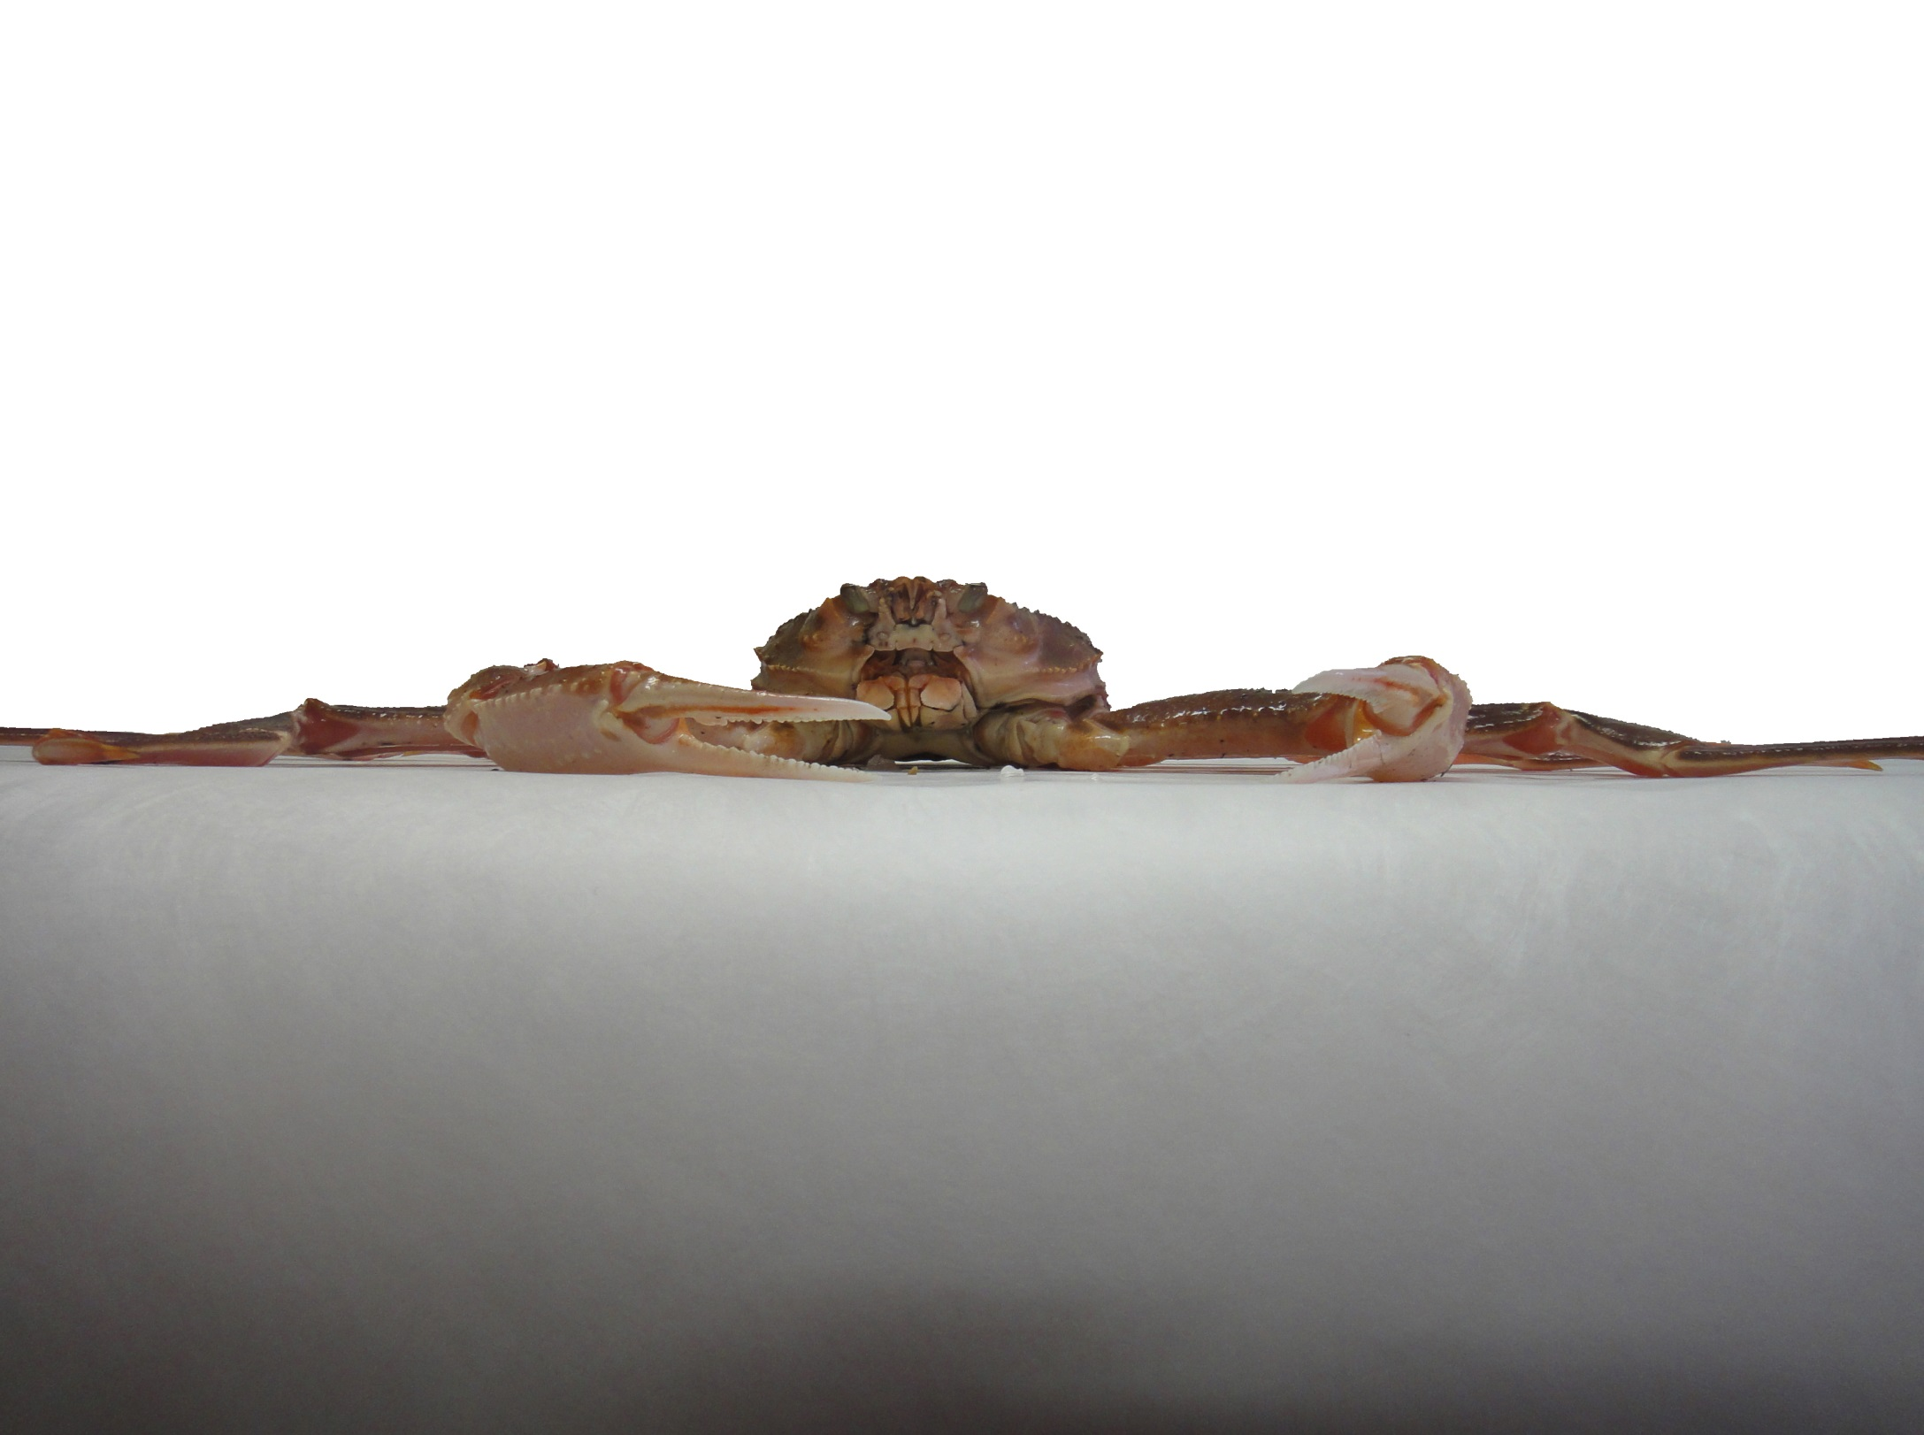
Snow crab biological sampling Protocol in the southern Gulf of St. Lawrence.
Edition 2019

Slide 2
SAMPLING METHODS
The supervisor of the observers will advise which vessels the observers have to sample, as requested by DFO. The observers will have to conduct two types of sampling:
BEFORE DISCARDING (catch composition in traps):
Each observer will take a sub-sample of 40 male crab at random per trap before discarding. This should be done as follow:
1. Select randomly 40 crab (male).
2. Count the remaining male crab or make an estimate of the total number of male crabs.
The estimate of the total number of male crabs should be done by counting the number of male crabs in a crate multiplied by the number of full crates, then adding the number of male crabs in the last partially filled crate, if any. Then, add the number of the 40 crabs measured.
3. Measure the forty (40) male crab previously selected.

Slide 3
b) AFTER DISCARDING (catch composition of the landings): Each observer will take a random sub-sample of twenty (20) male crab after discarding.
THESE TWO TYPES OF SAMPLING HAVE TO BE DONE FOR THE ENTIRE FISHING ACTIVITY.
THESE TWO SAMPLES HAVE TO BE DONE RANDOMLY TO MAKE A RATIO OF (2-1). TWO SAMPLES BEFORE DISCARDING TO ONE SAMPLE AFTER DISCARDING FOR THE ENTIRE FISHING ACTIVITY.

Slide 4
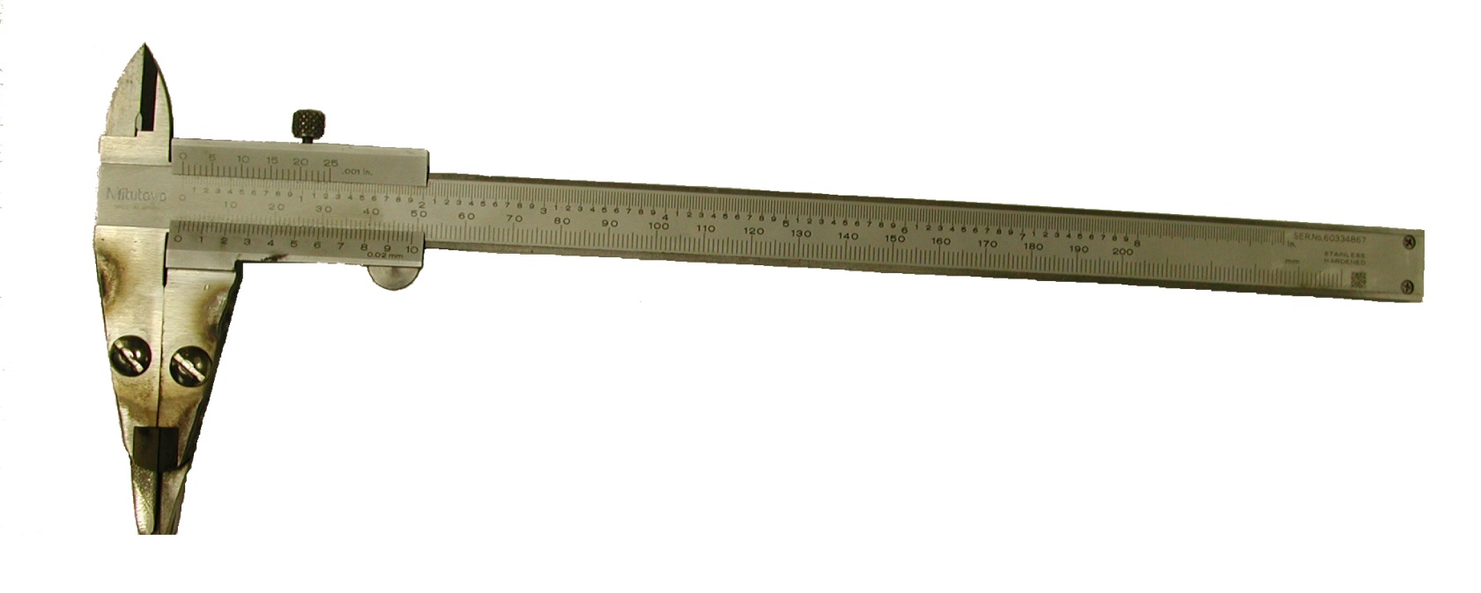
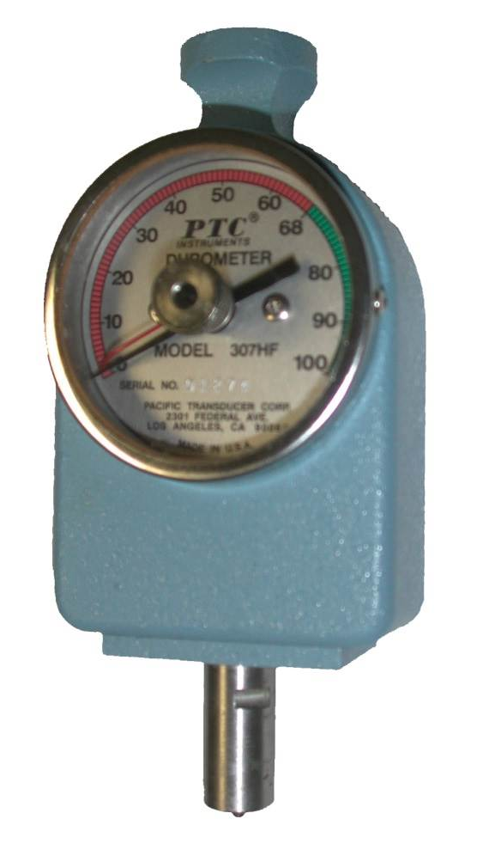
Biological sampling method
EQUIPMENT USED ON FIELD (by observer)
-caliper
-durometer

Slide 5
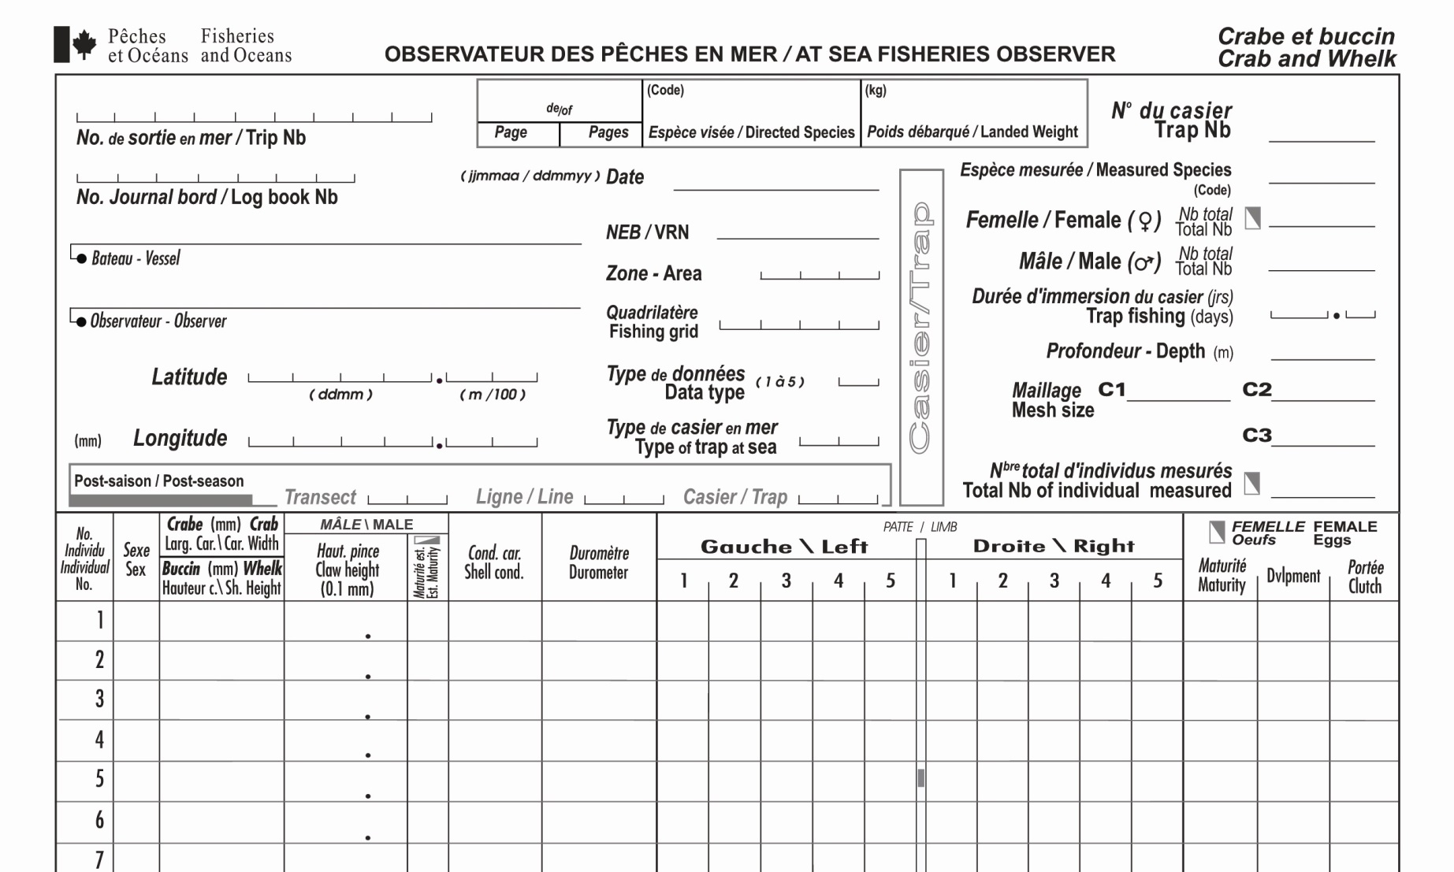
-Biological sampling sheet
6
7
8
9
10
11
12
1
13
2
14
3
15
4
16
17
5
18
19
20
21
22
23
24
25
26

Slide 6
1- TRIP NUMBER: The company provides that number to the observer and it should be written on each sampling sheet.
2- LOGBOOK NUMBER: This number is at the bottom of the logbook (example: C604502 or 343444).
3- VESSEL: The name of the boat should be put on all the sampling sheets of the trip.
4- OBSERVER: Each observer is to place his / her name on all of the sampling sheets.
5- POSITION: The position and the depth where the trap is sampled. The position has to be in latitude / longitude (degrees, minutes, 100 of minute).
6- PAGE: The sampling sheet should be numbered in the following way: the sampling sheet number by the total number of pages per trip.
7- DIRECTED SPECIES: Code to be determine by the company.

Slide 7
8- DATE: The date at the time the sample is taken.
9- VRN: The vessel registration number (VRN) on all of the sampling sheets.
10- AREA: 12 - Area 12, 18, 25 / 26 19 - Cape Breton 19
E - Area 12E F - Area 12F
11- FISHING GRID: Grid of 10 minutes by 10 minutes surface ex: HA 36
12- LANDED WEIGHT (KG): Total weight of the landing in kilograms (kg).
13- TRAP NUMBER: This is the number of the trap sampled and have to be written on each sampling sheet.
14- MEASURED SPECIES; See company code for snow crab.
15- MALES: Total number or estimate number of males in the trap included the 40 measured crabs.
16- TRAP FISHING (DAYS): Number of fishing days for the sampled trap (ex: 36 hours = 1.5 days)
17- DEPTH (m): The depth has to be in meter (m).

Slide 8
18-DATA TYPE: 1 - Landing (after discarding)
2 - Trap at sea (before discarding)
19-TYPE OF TRAP AT SEA: See code for the type of trap of the company.
20- TOTAL NUMBER OF INDIVIDUAL MEASURED :
21-SEX: Only the male crabs are measured. Male (M)
22-CARAPACE WIDTH: Maximal width of the carapace at the lateral margin.
23-CLAW HEIGHT: Maximal height of the right claw. Take the left claw if there is no right claw.
24-SHELL CONDITION: See description on carapace conditions.
25-DUROMETER: Should be taken at the base of the claw.
26-Limb: Missing legs with a black caps. Regenerated legs. (see pictures).

Slide 9
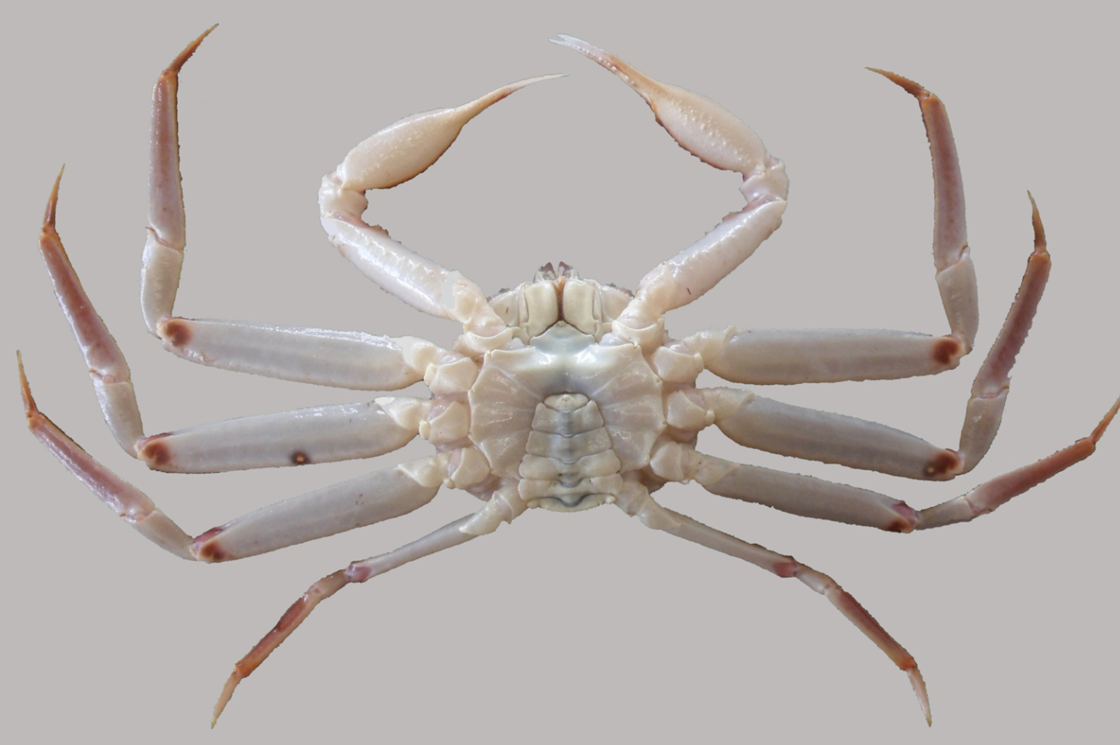
CARAPACE CONDITION:
1. New soft (Condition 1): The dorsal surface of the carapace is light brown and underneath is white. The carapace is clean (no moss) and rather soft. The claw is very shiny and easily broken under thumb pressure.

Slide 10
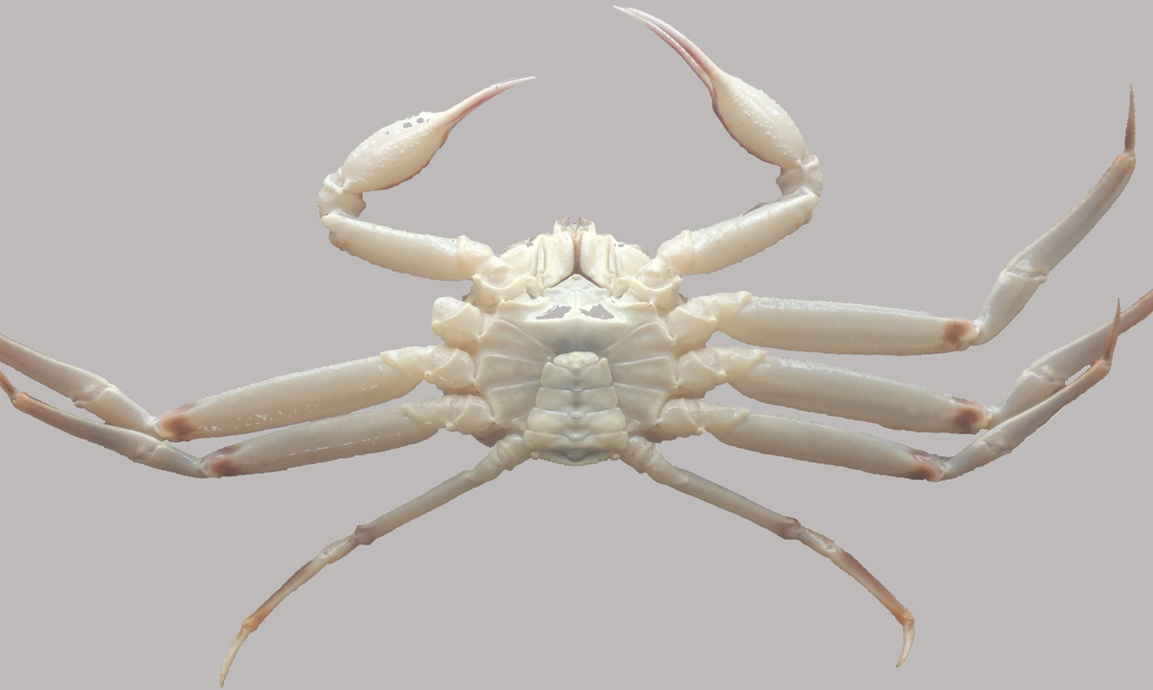
2. New hard (Condition 2): The dorsal surface of the carapace is light brown and underneath is white. The carapace is clean (no moss) and hard. Compared with a crab of condition 1, the claw is hard to break and less shiny.

Slide 11
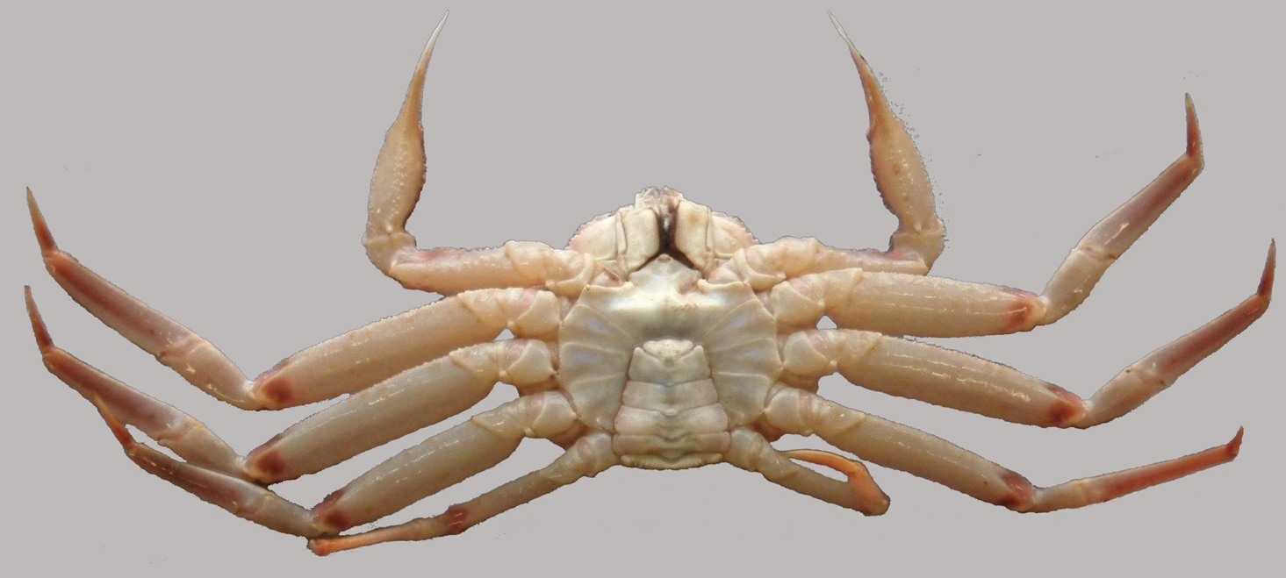
3. Intermediate (Condition 3): The dorsal surface of the carapace is light brown and underneath is yellow-brown. An accumulation of moss could become visible on the shell and very few organisms (white spots) appear on the dorsal part. The claw is hard and still shiny. This crab should be cleaned at the processing plant.

Slide 12
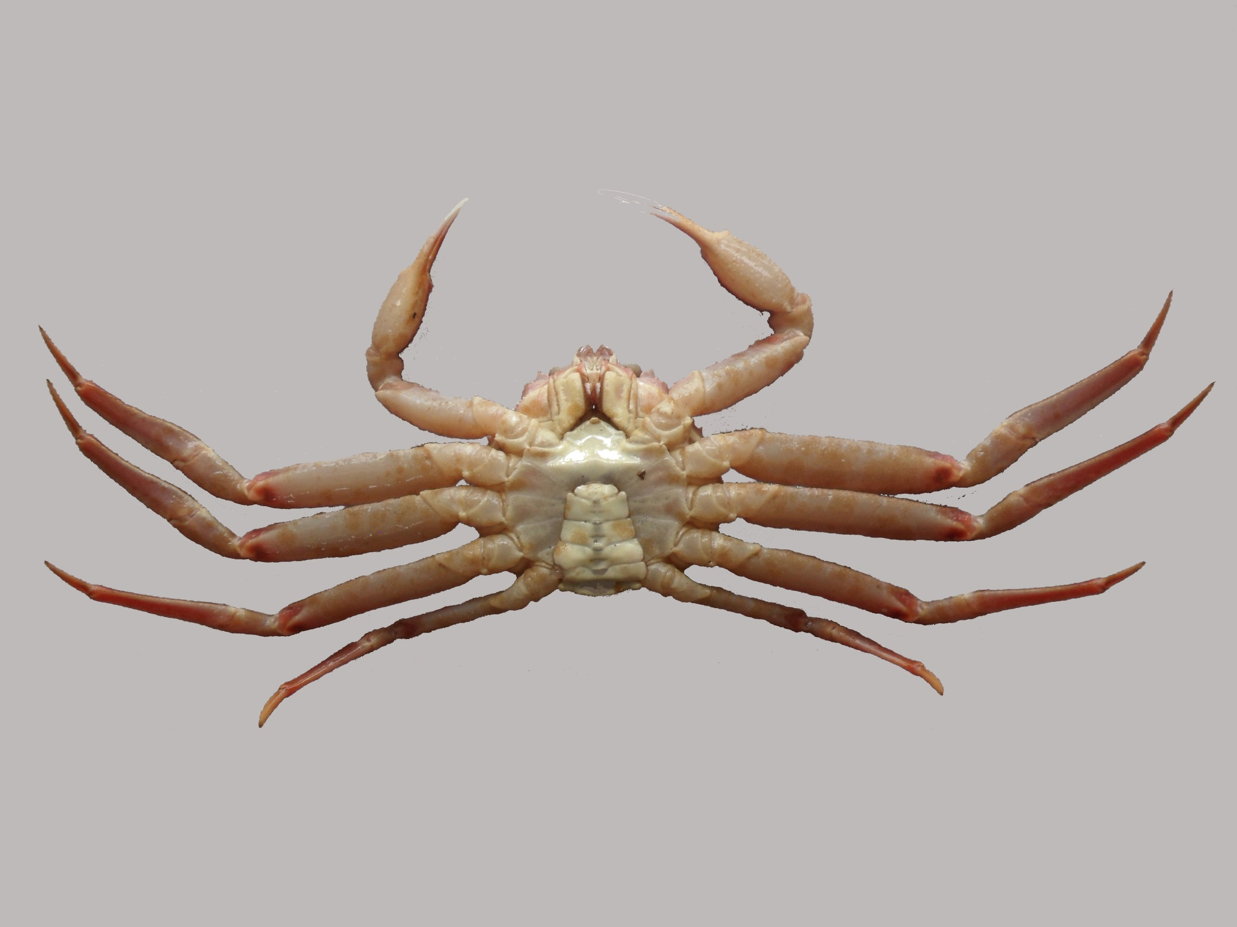

Slide 13
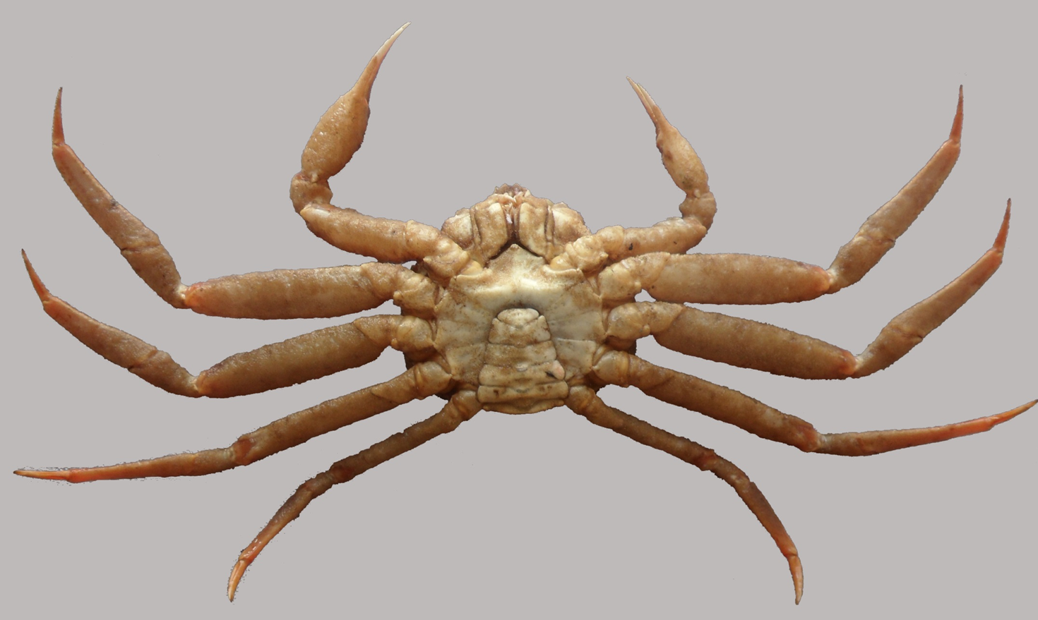
4. Old (Condition 4): The dorsal surface of the carapace is light brown and underneath is yellow-brown. There is some small scars and accumulated organisms (white spots and moss) on the carapace. The claw doesn’t shine. This crab needs to be cleaned at the processing plant.

Slide 14
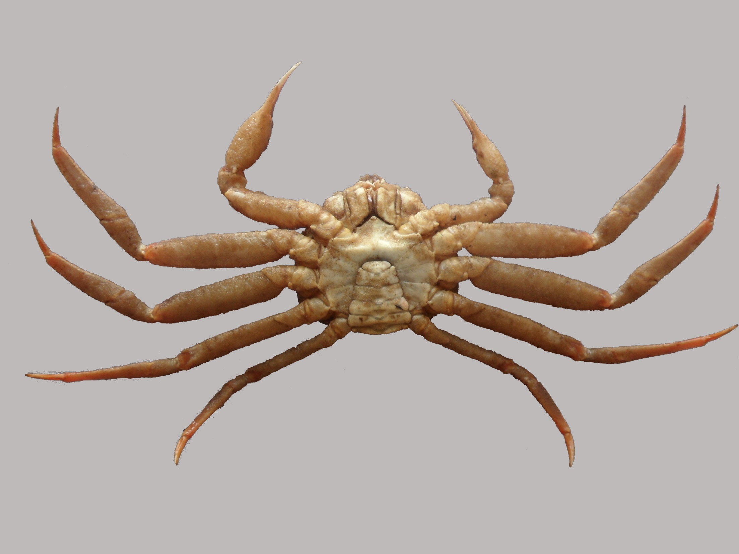

Slide 15
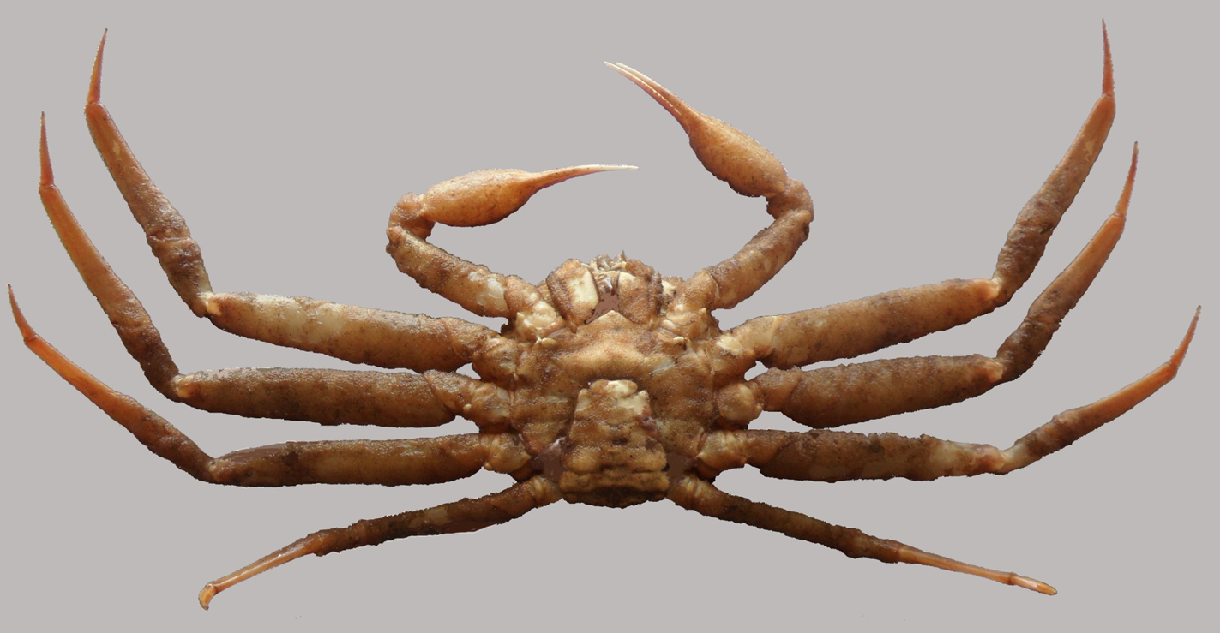
Very old (Condition 5): The carapace is old, very dirty (moss) and could be soft. A decalcification is noticeable, especially at the joints of the legs. The moss is not removable at the processing plant.

Slide 16
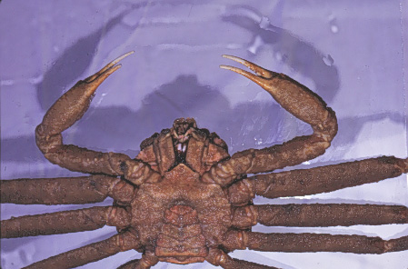

Slide 17
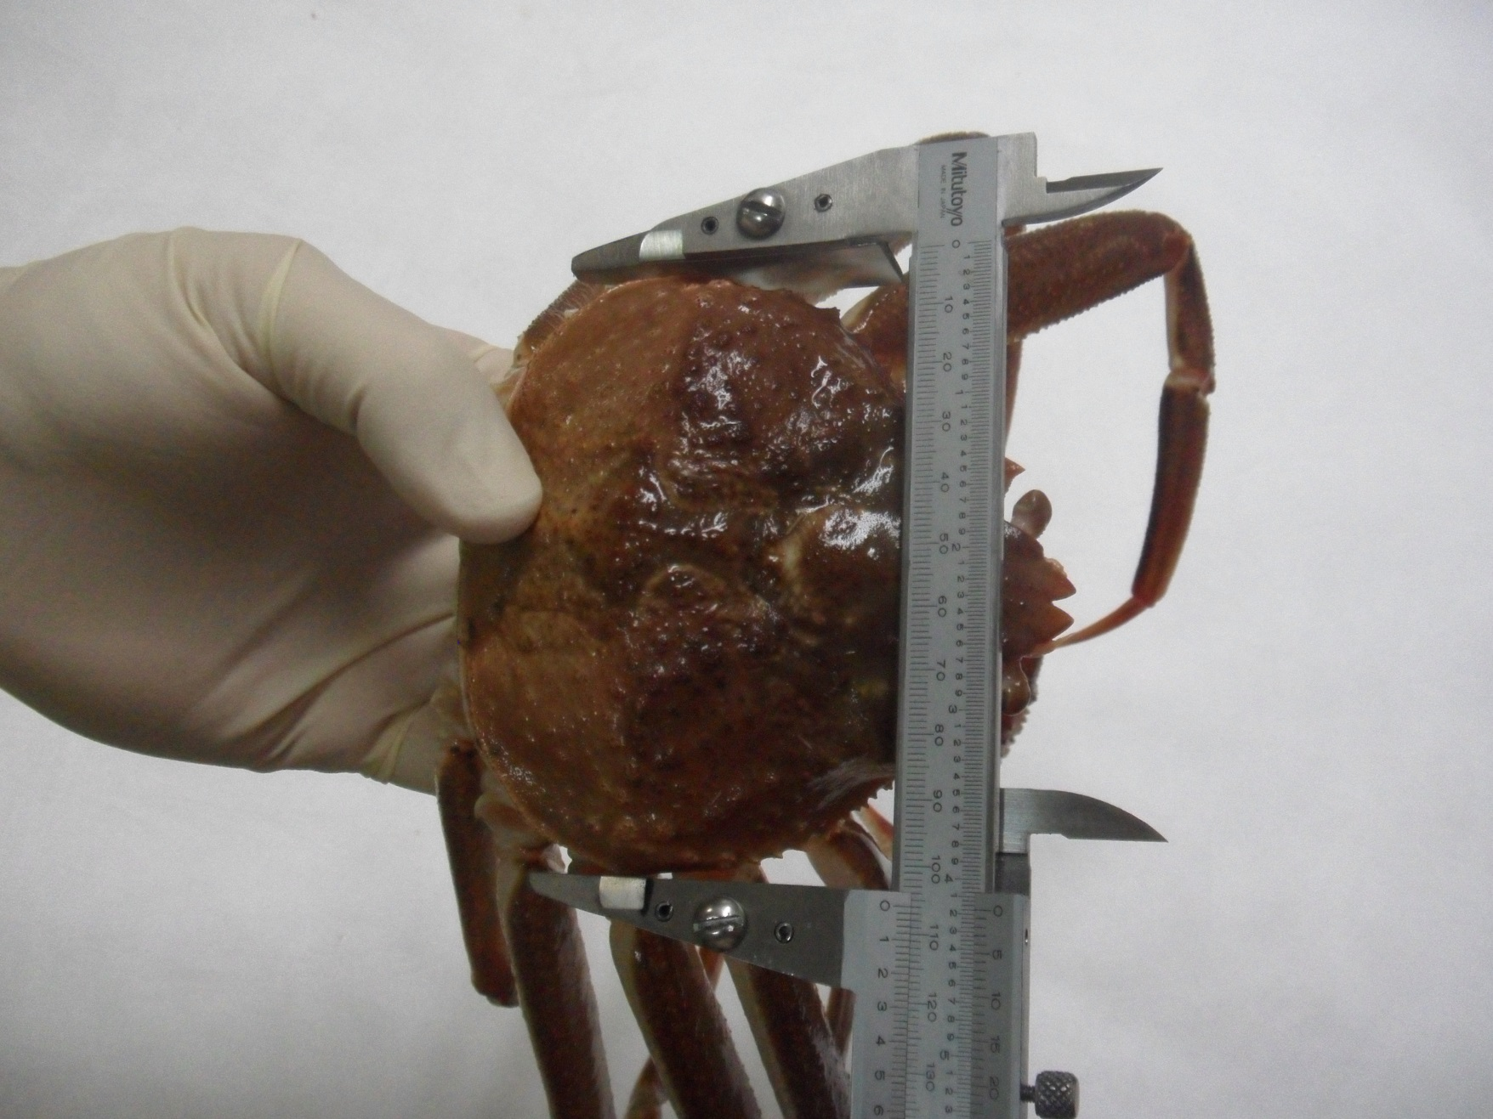
Carapace width

Slide 18
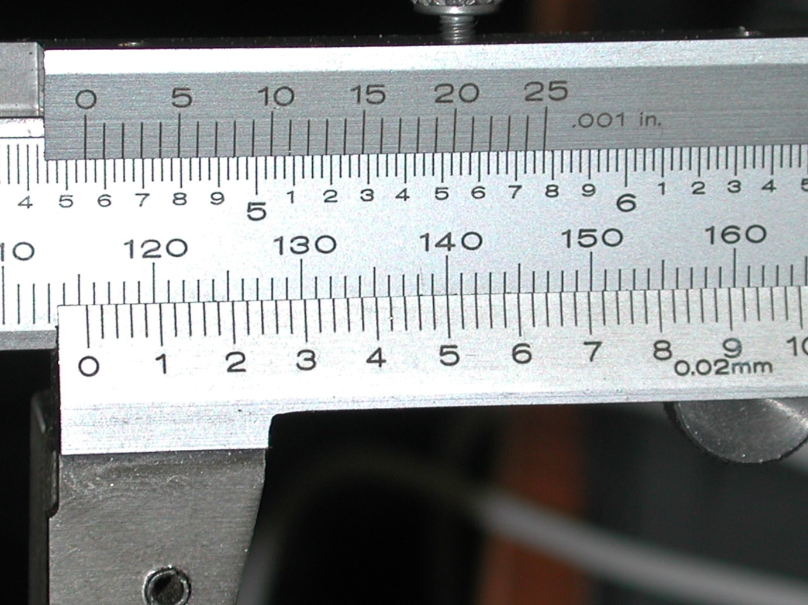
Caliper reading
115 mm
115.54 mm

Slide 19
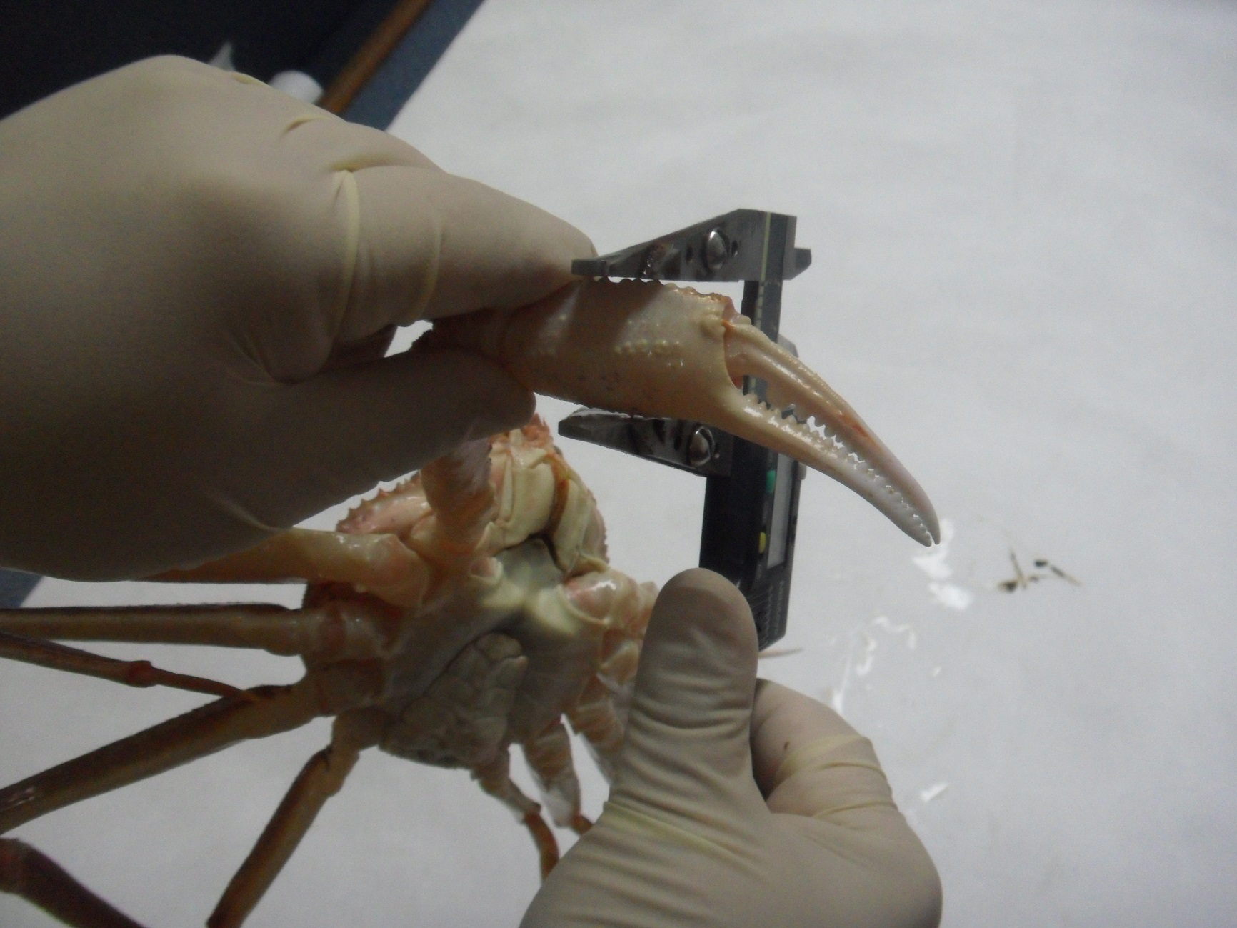
Right claw height

Slide 20
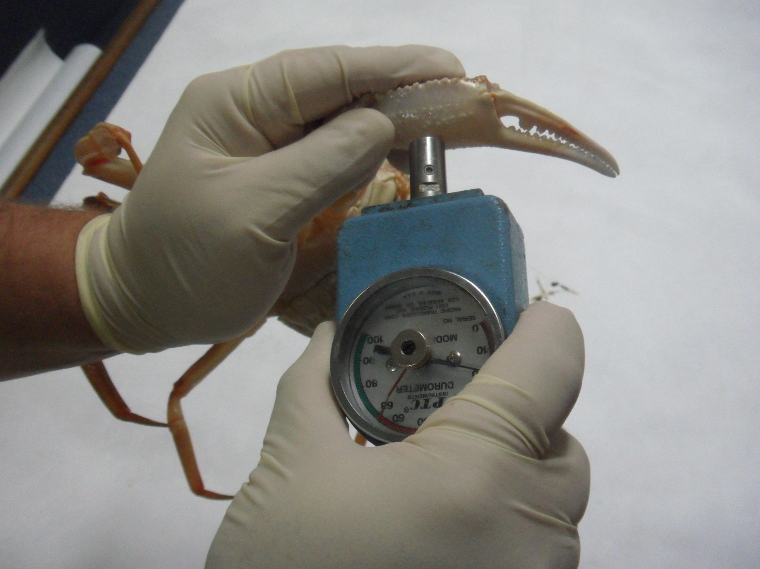
Durometer on the right claw

Slide 21
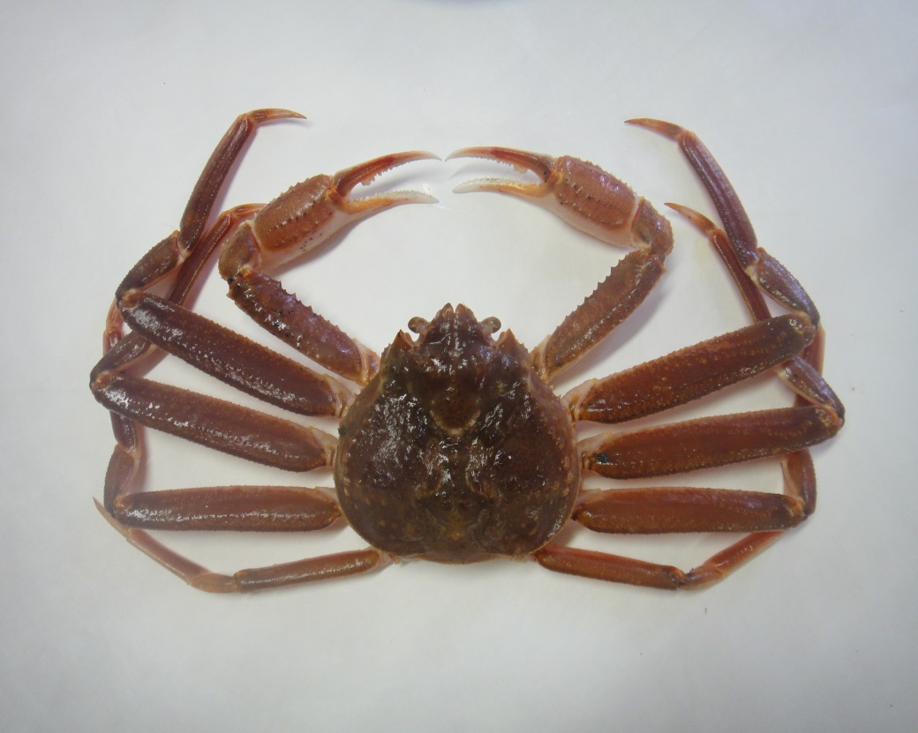
Missing legs
Left / Gauche
Right / Droite
1
1
2
2
3
3
4
4
5
5

Slide 22
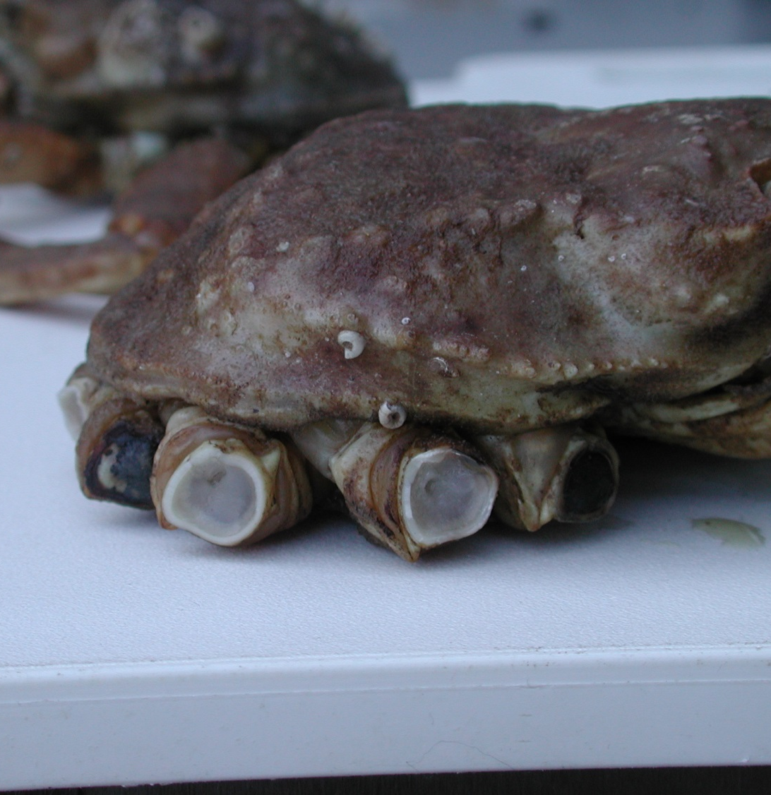
Missing legs
Missing leg
Leg broken by manipulation

Slide 23
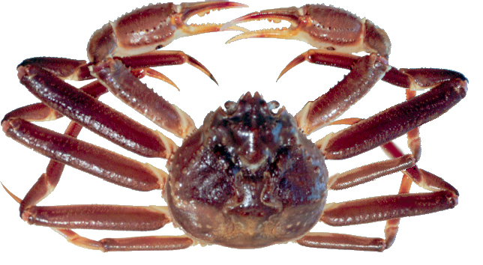
Regenerated legs
Regenerated leg

Slide 24
Observer data in 2019 (issues)
Carapace width
Data are sometimes rounded to the nearest 10mm, 5mm or 2mm. All data are to be read to the nearest millimeter.
Round off carapace width measurements automatically affects the corresponding chela height measures.

Slide 25
No rounding of the carapace width
100
200
80
150
60
Frequency
Frequency
100
40
20
50
0
0
60
70
80
90
100
110
120
0
2
4
6
8
Value
Last digit

Slide 26
Rounding by tens of the carapace width
200
500
n = 2000
150
400
Frequency
Frequency
300
100
200
50
100
0
0
60
70
80
90
100
110
120
0
2
4
6
8
Value
Last digit

Slide 27
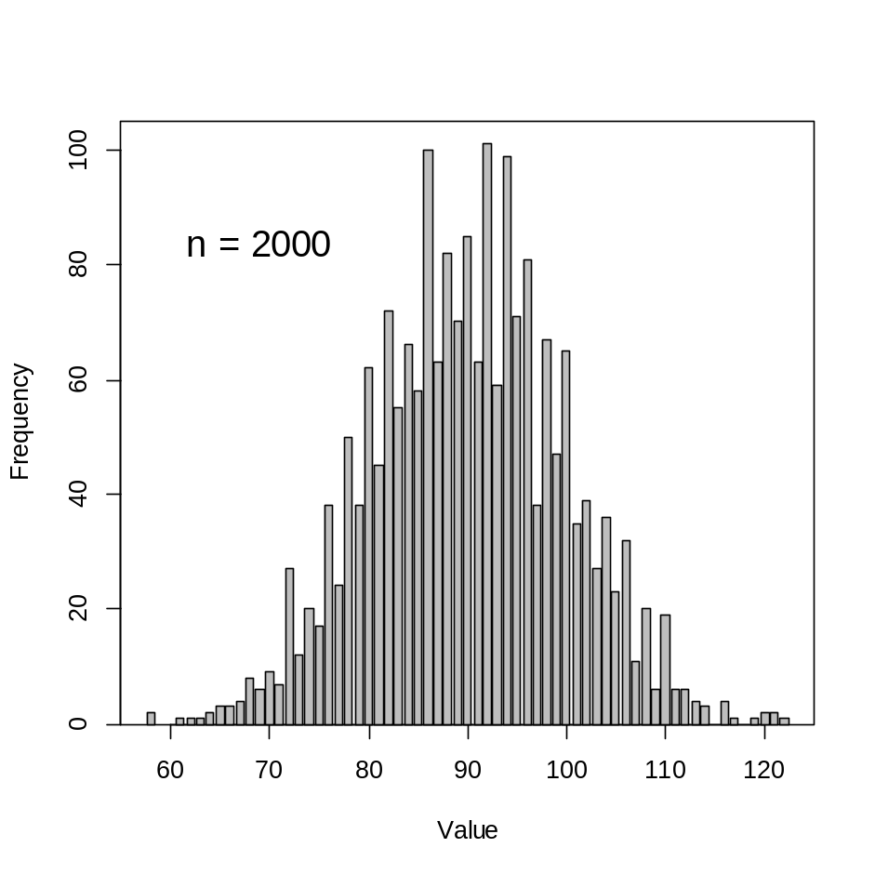
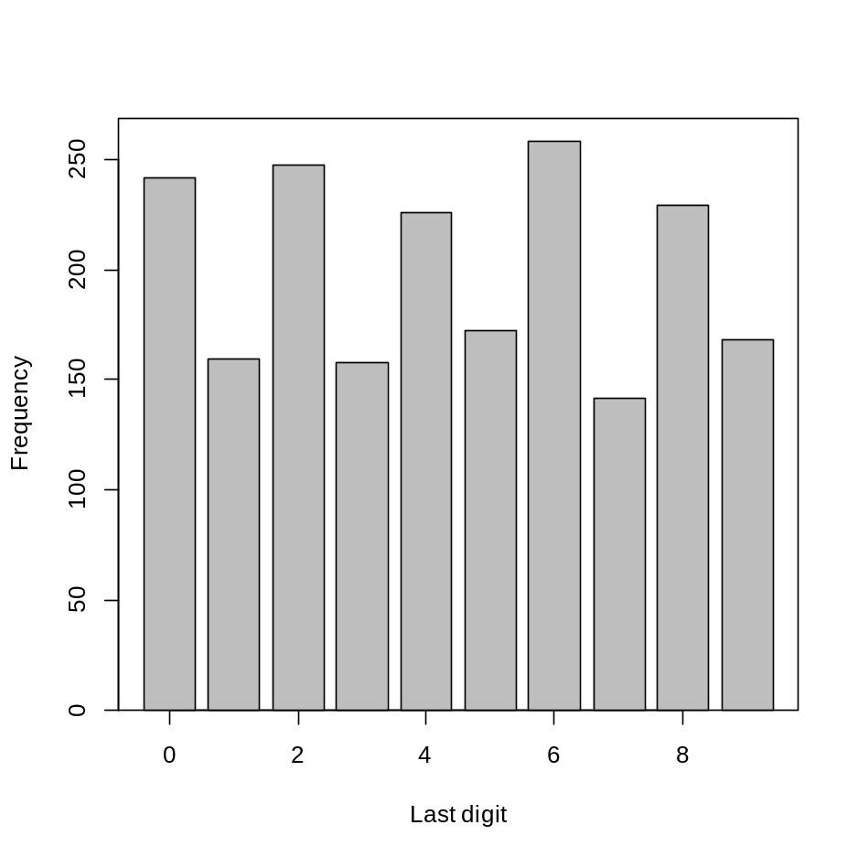
Rounding by pairs of the carapace width

Slide 28
Carapace width
The 95mm is not a special case. There are cases where the frequency of 94 or 96mm values are changed because the 95mm measure is either too favored or avoided.
Making up numbers is detectable. It is very hard for a human to generate ‘real’ looking data.

Slide 29
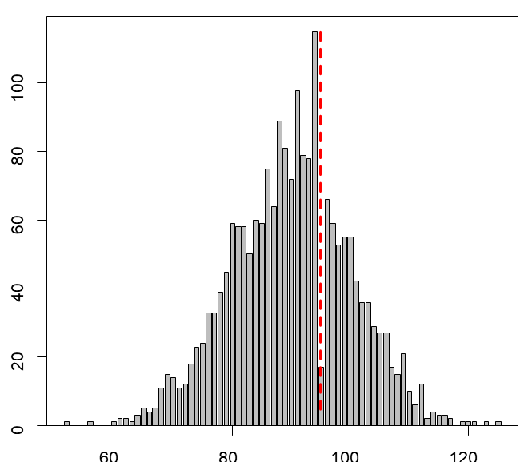
Avoiding 95 mm of carapace width
Frequency
Carapace width

Slide 30
Chela height
Used to identify crab maturity.
  Very important to measure it correctly, otherwise maturity cannot be determined.
40+% observers have some level of bias in their measurements. Due to either faulty rounding habits or incorrect chela height technique.

Slide 31
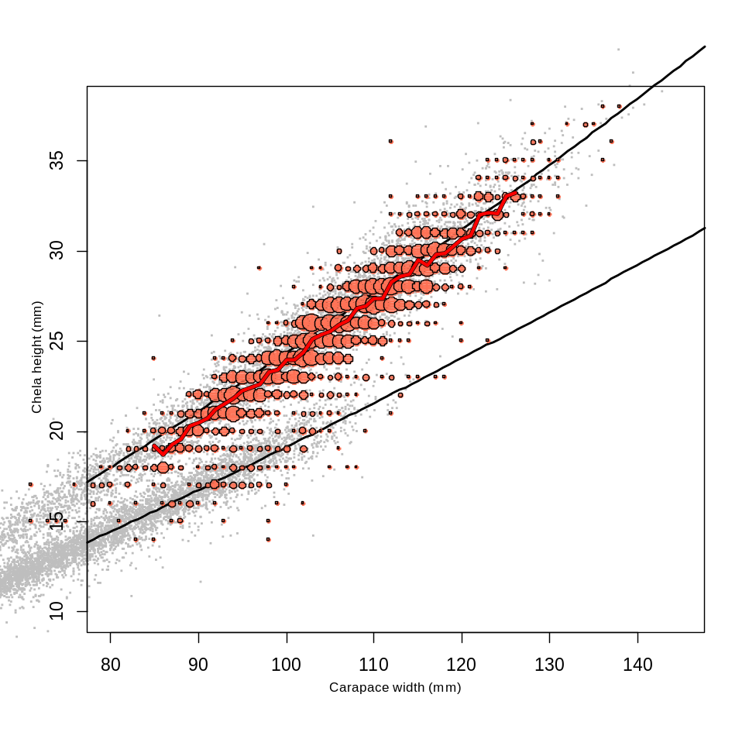
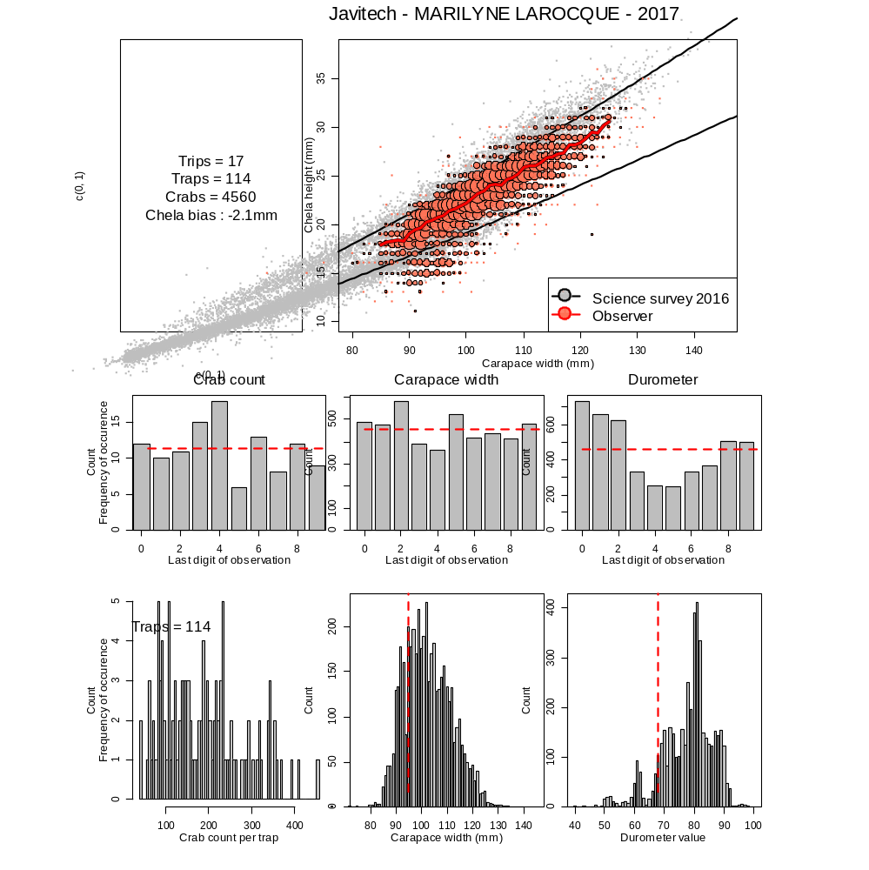
Bias in claw height measurements
Survey Data versus Observer
Claw height (mm)
Carapace width (mm)

Slide 32
Chela height
Read to nearest millimeter. No rounding.
Some observers avoid sampling adolescents, a true random sample of the catch is required.

Slide 33
Carapace condition
Used in identifying future new recruits and commercially exploited males. Also used in the soft crab protocol.
Differences between CC2 and CC3 in the Québec and Gulf regions.
Some observers never have CC1 or CC2. This is very unlikely.

Slide 34
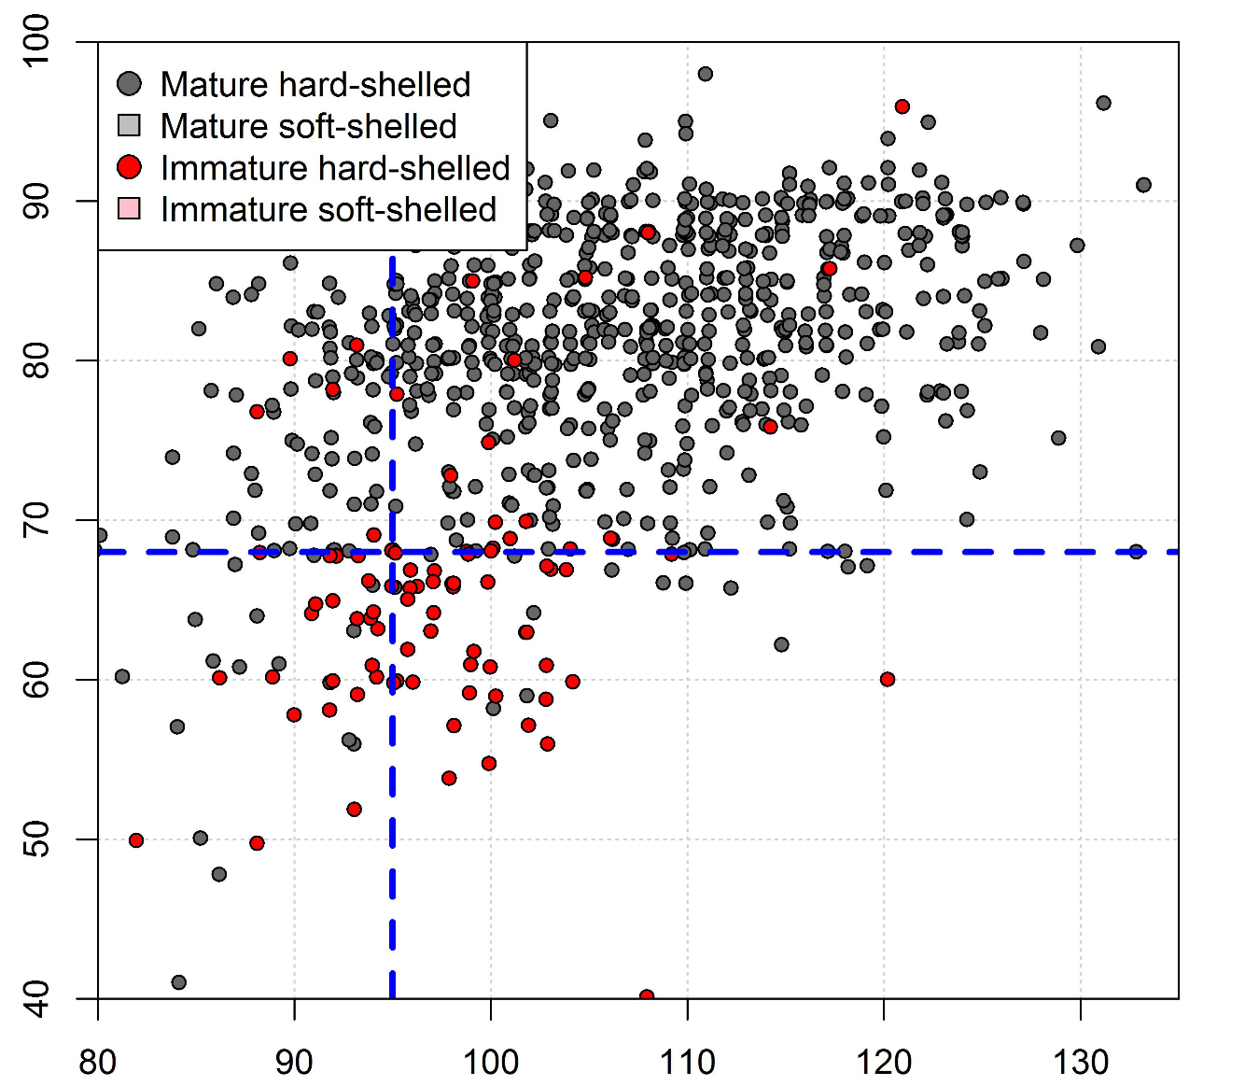
No soft-shelled crab observed
Durometer
Carapace width (mm)

Slide 35
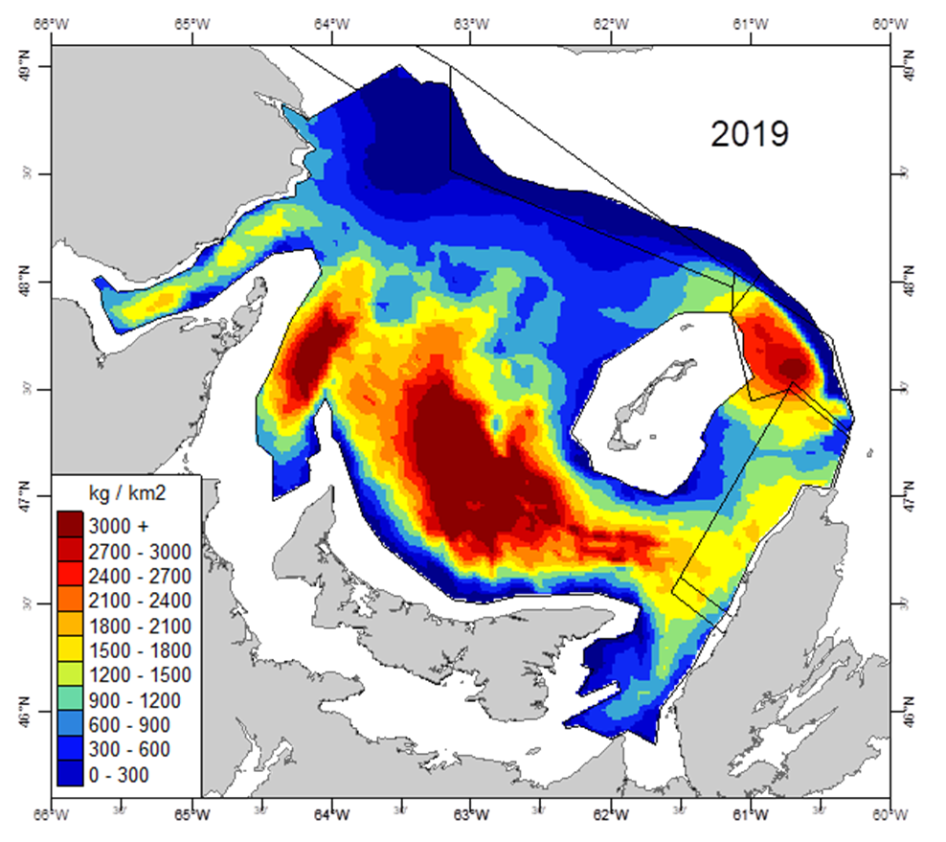
Commercial biomass for the 2020 fishery

Slide 36
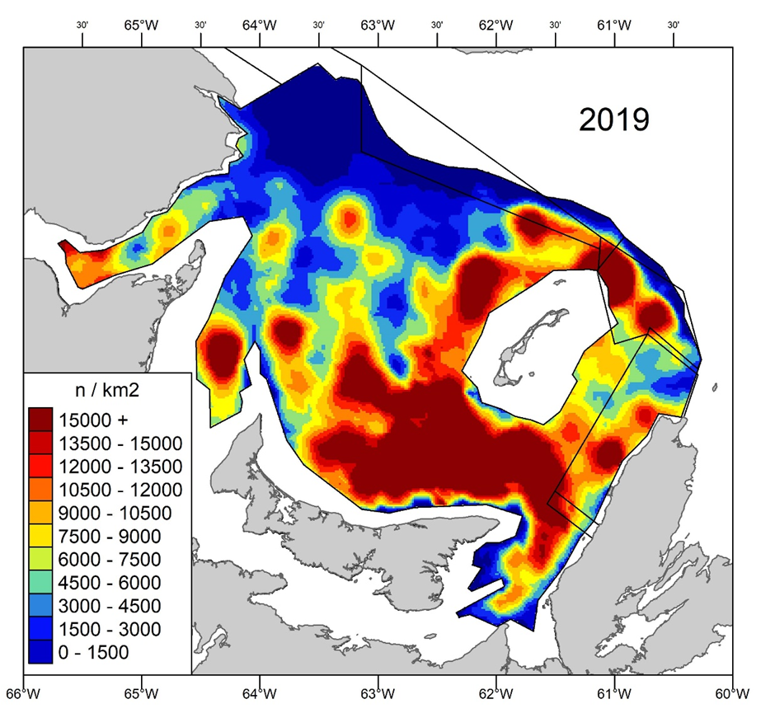
Geographic distribution of adolescent male larger
than 56 mm of carapace width

Slide 37
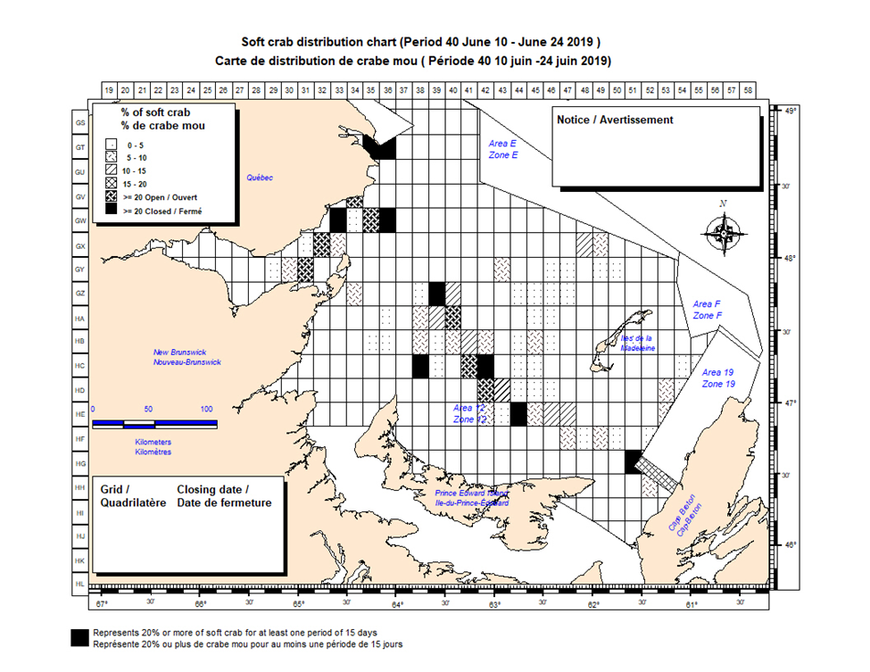
Soft-shelled crab protocol

Slide 38
Missing legs
Used to assess quality of crab as well as an index of predation or competition.
Important to better determine the missing legs, regenerated legs or missing legs by manipulation.

Slide 39
Durometer
Used to identify carapace stage of hardness and implementation of soft crab protocol.
No rounding or truncating values.
Durometer inspections and calibration.

Slide 40
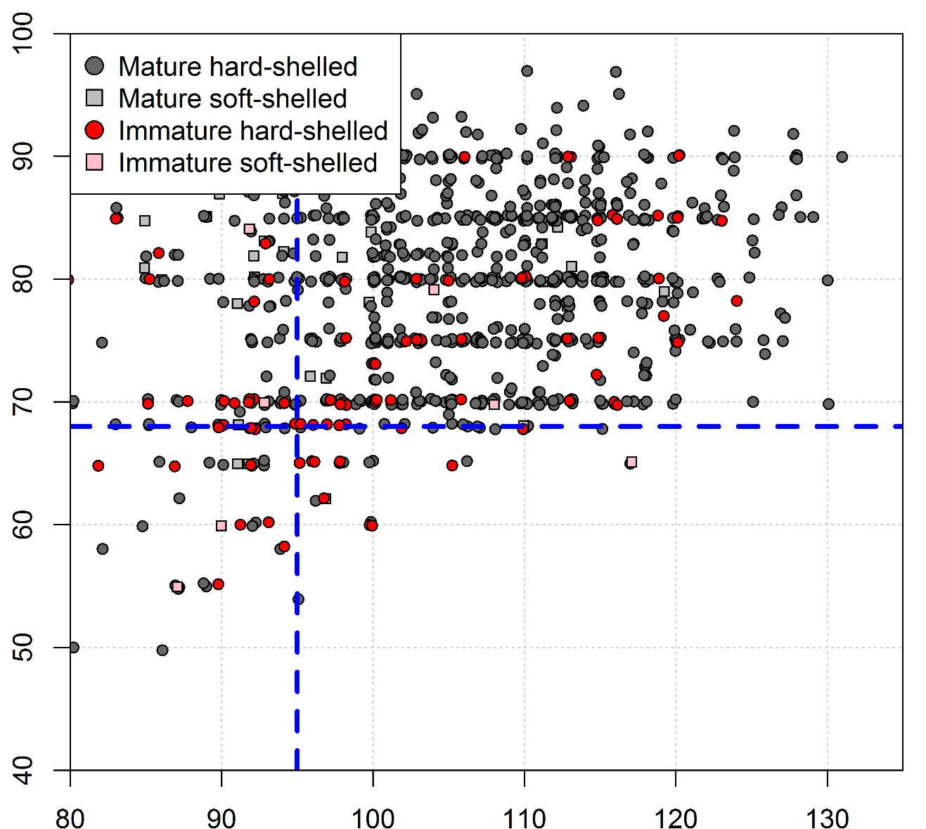
Rounding of durometer values
Durometer
Carapace width (mm)

Slide 41
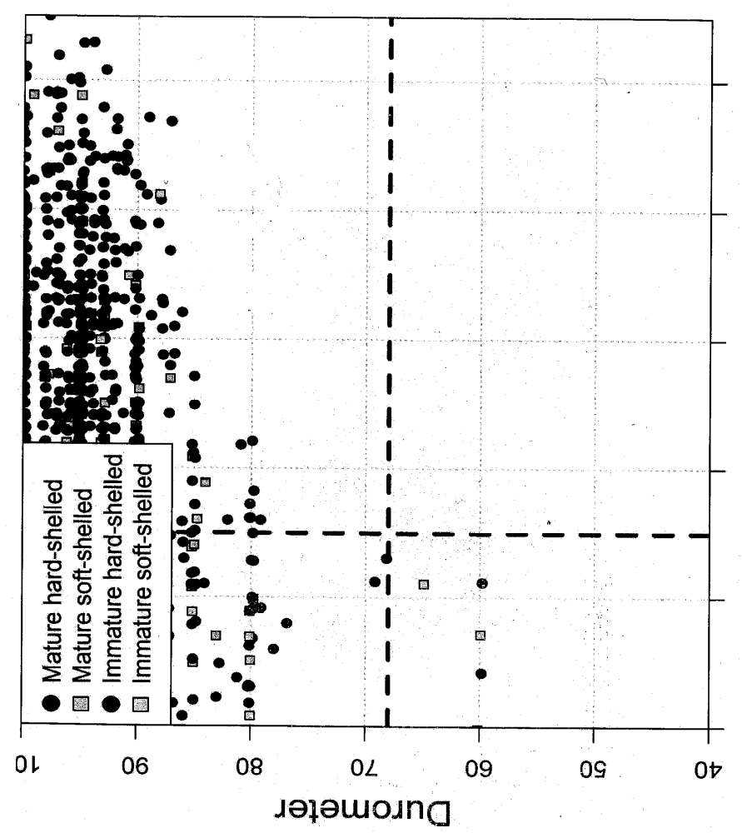
High durometer values
Falsification or broken durometer
Durometer
Carapace width (mm)

Slide 42
Crab counting
Used to calculate fishery performance (Catch per unit of effort).
Numbers are either counted or approximated using inappropriated method. Deviations from this protocol will be detected and reported.

Slide 43
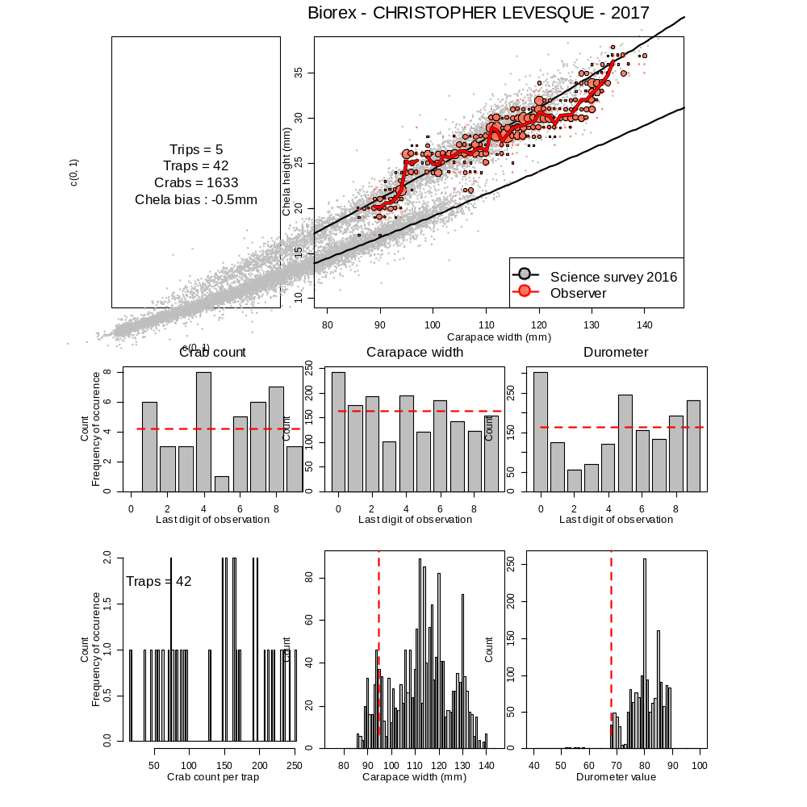
Observer profile
Pattern in claw size is completely unrealistic.
Carapace width measurements rounded at 110, 120 and 130mm.
Durometer measurements truncated at the lower limit of 68.

Slide 44
Why the observer data are important
Soft-shelled crab protocol
To minimize the mortality of soft-shelled crab by handling. The soft-shelled crab
is the future recruitment to the exploitable biomass.
Catch composition
Ageing of the population
Distribution of fishing effort
Catch rates (CPUE)

Slide 45
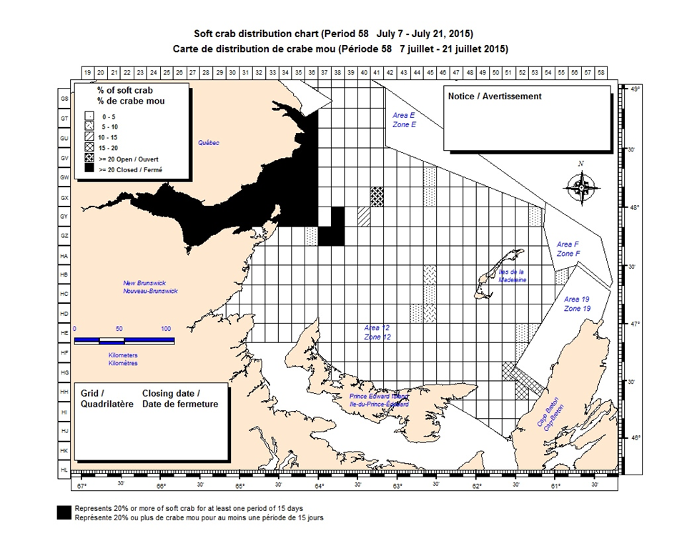
Soft-shelled crab protocol

Slide 46
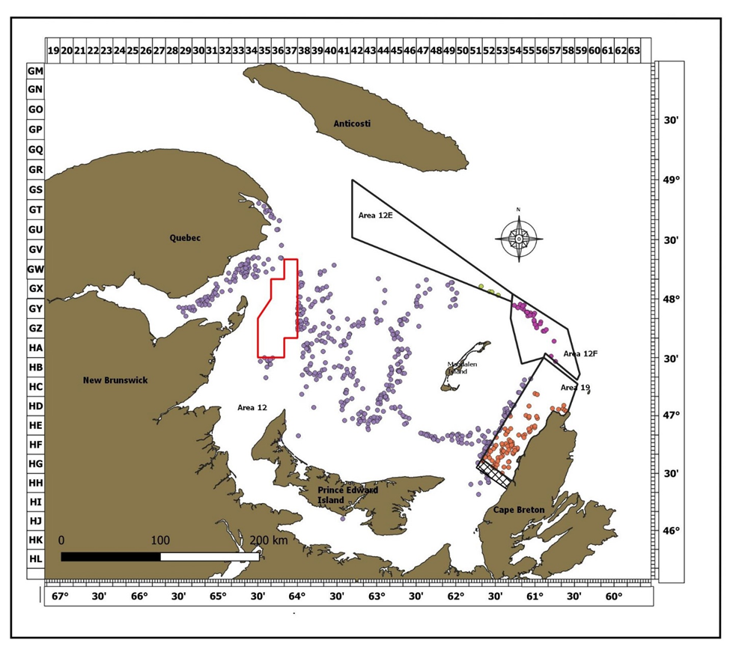
Overview of effort distribution for the 2019 fishery (from the observer data)

Slide 47
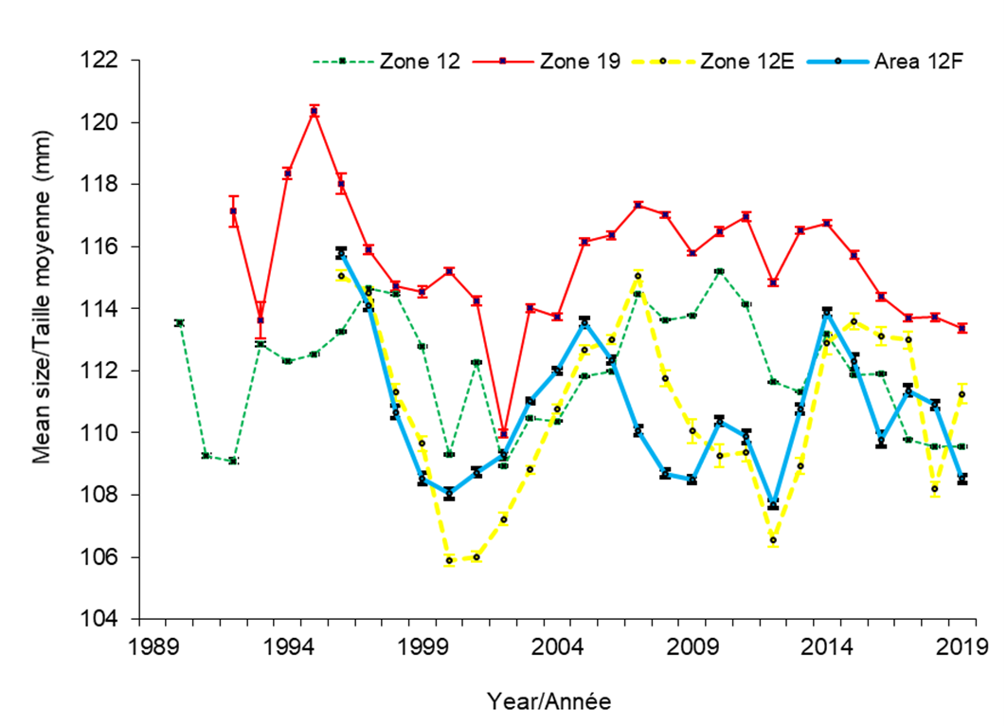
Mean size of commercial-sized adult males in traps

Slide 48
Percentage by carapace conditions of commercial-sized adult males
Year | Area 12 |  |  |  |  | Area 19
 | CC 1 | CC 2 | CC 3 | CC 4 | CC 5 | CC 1 | CC 2 | CC 3 | CC 4 | CC 5
2010 | 1.3 | 3.2 | 78.9 | 14.8 | 1.8 | 1.3 | 10.9 | 67.6 | 18.2 | 2.0
2011 | 2.2 | 4.5 | 75.5 | 15.8 | 1.9 | 0.6 | 11.6 | 80.0 | 7.5 | 0.3
2012 | 0.4 | 1.8 | 87.4 | 9.9 | 0.6 | 0.5 | 5.1 | 91.6 | 2.7 | 0.1
2013 | 0.2 | 2.4 | 87.5 | 9.5 | 0.4 | 0.7 | 6.8 | 58.1 | 34.3 | 0.1
2014 | 0.6 | 1.1 | 86.5 | 11.3 | 0.5 | 0.0 | 1.2 | 86.7 | 12.1 | 0.0
2015 | 0.3 | 1.0 | 88.1 | 10.3 | 0.3 | 0.8 | 3.1 | 86.1 | 9.9 | 0.1
2016 | 0.5 | 1.3 | 89.0 | 8.8 | 0.4 | 4.3 | 10.8 | 71.4 | 13.1 | 0.4
2017 | 1.0 | 3.2 | 88.6 | 6.9 | 0.3 | 1.5 | 5.5 | 81.2 | 11.6 | 0.2
2018 | 0.6 | 1.9 | 88.4 | 9.1 | 0.0 | 0.5 | 2.9 | 87.3 | 9.3 | 0.0
2019 | 0.9 | 2.5 | 88.8 | 7.2 | 0.6 | 4.0 | 6.3 | 79.3 | 9.4 | 1.0

Slide 49
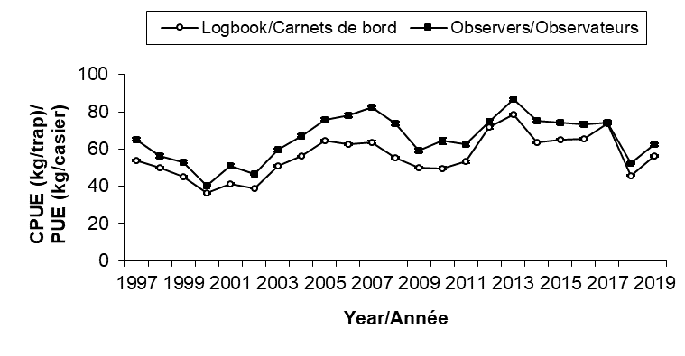
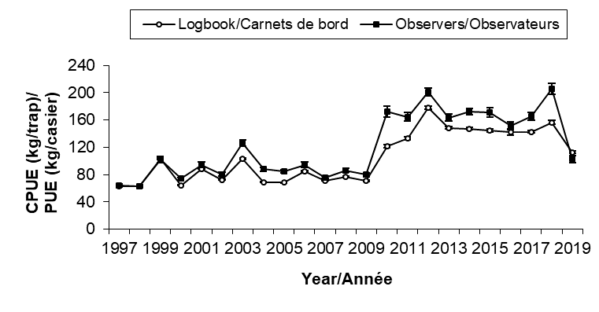
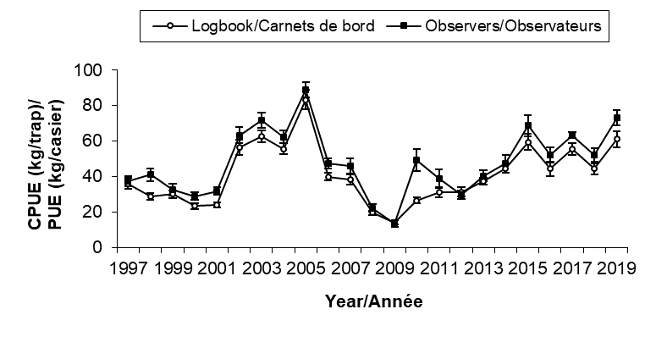
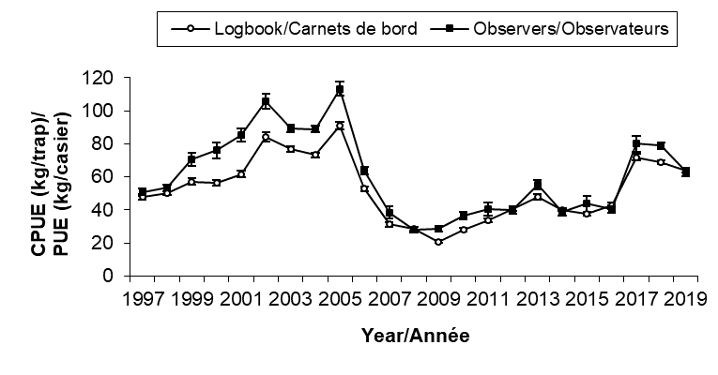
CPUE comparison between logbooks vs. Observer data
Area 12
Area 19
Area 12E
Area 12F

Slide 50
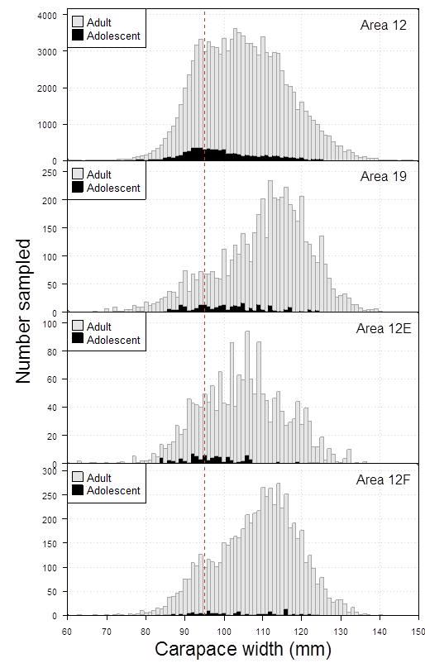
Size frequency distribution

Slide 51
Thank You!

